Slide 2
Overview
Digital Systems and Computer Systems
Information Representation
Number Systems [binary, octal and hexadecimal]
Arithmetic Operations
Base Conversion
Decimal Codes [BCD (binary coded decimal), parity]
Gray Codes
Alphanumeric Codes

Slide 3
Digital System
Takes a set of discrete information inputs and discrete internal information (system state) and generates a set of discrete information outputs.
Discrete
Discrete
Inputs
Information
Discrete
Processing
Outputs
System
System State

Slide 4
Types of Digital Systems
No state present
  Combinational Logic System
  Output = Function(Input)
State present
  State updated at discrete times
  => Synchronous Sequential System
  State updated at any time
  =>Asynchronous Sequential System
  State = Function (State, Input)
  Output = Function (State)
  or Function (State, Input)

Slide 5
Digital System Example:
A Digital Counter (e. g., odometer):
Count Up
0
0
1
3
5
6
4
Reset
Inputs:
Count Up, Reset
Outputs:
Visual Display
State:
"Value" of stored digits
Synchronous or Asynchronous?
Chapter 1 <number>

Slide 6
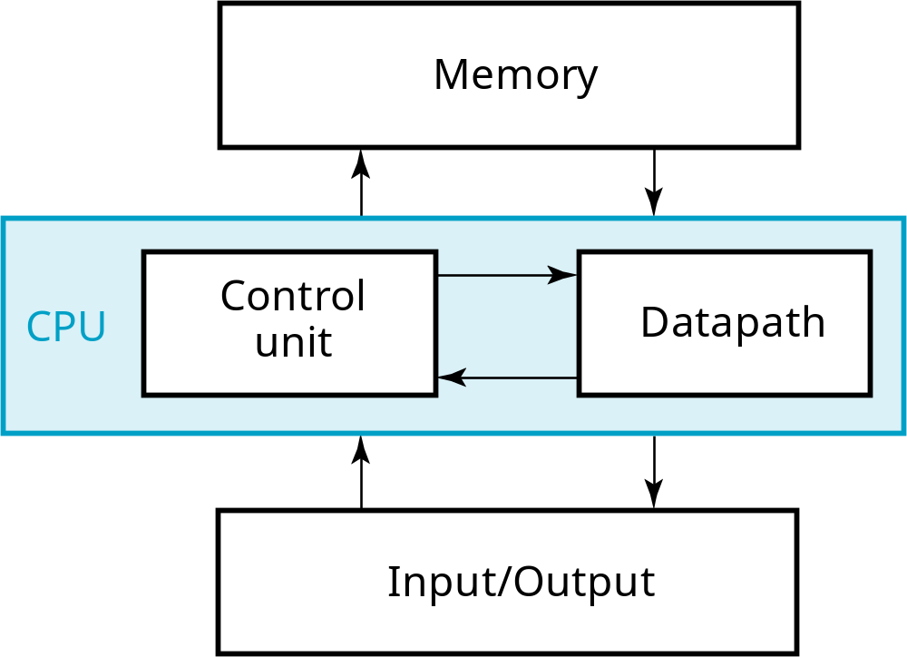
A Digital Computer Example
Inputs: Keyboard, mouse, modem, microphone
Outputs: CRT, LCD, modem, speakers
Synchronous or Asynchronous?
Chapter 1 <number>
Notes:
Answer: Part of specification for a PC is in MHz. What does that imply? A clock which defines the discrete times for update of state for a synchronous system. Not all of the computer may be synchronous, however.

Slide 7
Signal
An information variable represented by physical quantity.
For digital systems, the variable takes on discrete values.
Two level, or binary values are the most prevalent values in digital systems.
Binary values are represented abstractly by:
  digits 0 and 1
  words (symbols) False (F) and True (T)
  words (symbols) Low (L) and High (H)
  and words On and Off.
Binary values are represented by values or ranges of values of physical quantities

Slide 8
Signal Examples Over Time
Time
Continuous in value & time
Analog
Digital
Discrete in value & continuous in time
Asynchronous
Synchronous
Discrete in value & time
Chapter 1 <number>

Slide 9
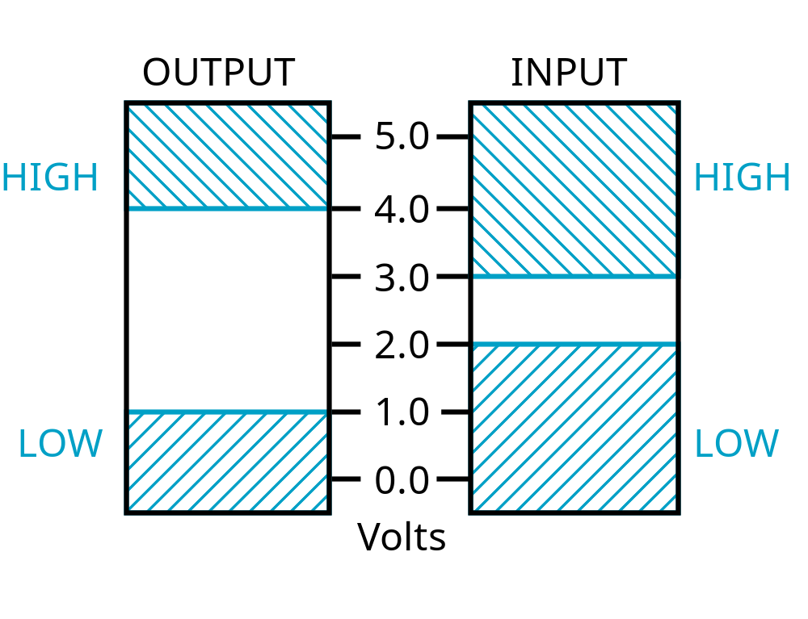
Signal Example – Physical Quantity: Voltage
Threshold Region
Notes:
The HIGH range typically corresponds to binary 1 and LOW range to binary 0. The threshold region is a range of voltages
for which the input voltage value cannot be interpreted reliably as either a 0 or a 1.

Slide 10
Binary Values: Other Physical Quantities
What are other physical quantities represent 0 and 1?
  CPU Voltage
  Disk
  CD
  Dynamic RAM
Magnetic Field Direction
Surface Pits/Light
Electrical Charge

Slide 11
Number Systems – Representation
Positive radix, positional number systems
A number with radix r is represented by a string of digits:
A_{n - 1}A_{n - 2} … A₁A₀ . A₋ ₁ A₋ ₂ … A_{- m + 1} A_{- m}
in which 0 ≤ A_{i} < r and . is the radix point.
The string of digits represents the power series:
(
)
(
)
i = n - 1
j = - 1
(Number)_{r}
=
∑
i
+
∑
j
A
r
A
r
i
j
i = 0
j = - m
(Integer Portion)
(Fraction Portion)
+

Slide 12
Number Systems – Examples
 | General | Decimal | Binary
Radix (Base) | r | 10 | 2
Digits | 0 => r - 1 | 0 => 9 | 0 => 1
0 1 2 3 Powers of 4 Radix 5 -1 -2 -3 -4 -5 | r⁰ r¹ r² r³ r⁴ r⁵ r ⁻¹ r ⁻² r ⁻³ r ⁻⁴ r ⁻⁵ | 1 10 100 1000 10,000 100,000 0.1 0.01 0.001 0.0001 0.00001 | 1 2 4 8 16 32 0.5 0.25 0.125 0.0625 0.03125

Slide 13
Special Powers of 2
2¹⁰ (1024) is Kilo, denoted "K"
2²⁰ (1,048,576) is Mega, denoted "M"
2³⁰ (1,073, 741,824)is Giga, denoted "G"
Chapter 1 <number>

Slide 14
Positive Powers of 2
Useful for Base Conversion
Exponent
Value
Exponent
Value
0
1
11
2,048
1
2
12
4,096
2
4
13
8,192
3
8
14
16,384
4
16
15
32,768
5
32
16
65,536
6
64
17
131,072
7
128
18
262,144
8
256
19
524,288
9
512
20
1,048,576
10
1024
21
2,097,152

Slide 15
Converting Binary to Decimal
To convert to decimal, use decimal arithmetic to form Σ (digit × respective power of 2).
Example:Convert 11010₂ to N₁₀:
Notes:
Powers of 2: 43210
11010₂ =>
1 X 2⁴ = 16
+ 1 X 2³ = 8
+ 0 X 2² = 0
+ 1 X 2¹ = 2
+ 0 X 2⁰ = 0
26₁₀

Slide 16
Converting Decimal to Binary
Method 1
  Subtract the largest power of 2 (see slide 14) that gives a positive remainder and record the power.
  Repeat, subtracting from the prior remainder and recording the power, until the remainder is zero.
  Place 1’s in the positions in the binary result corresponding to the powers recorded; in all other positions place 0’s.
Example: Convert 625₁₀ to N₂
Notes:
625 – 512 = 113 => 9
113 – 64 = 49 => 6
49 – 32 = 17 => 5
17 – 16 = 1 => 4
1 – 1 = 0 => 0
Placing 1’s in the result for the positions recorded and 0’s elsewhere,
9 8 7 6 5 4 3 2 1 0
1 0 0 1 1 1 0 0 0 1

Slide 17
Commonly Occurring Bases
Name
Radix
Digits
Binary
2
0,1
Octal
8
0,1,2,3,4,5,6,7
Decimal
10
0,1,2,3,4,5,6,7,8,9
Hexadecimal
16
0,1,2,3,4,5,6,7,8,9,A,B,C,D,E,F
The six letters (in addition to the 10
integers) in hexadecimal represent:
Chapter 1 <number>
Notes:
Answer: The six letters A, B, C, D, E, and F represent the digits for values
10, 11, 12, 13, 14, 15 (given in decimal), respectively, in hexadecimal.
Alternatively, a, b, c, d, e, f are used.

Slide 18
Numbers in Different Bases
Good idea to memorize!
Decimal
Binary
Octal
Hexa
decimal
(Base 10)
(Base 2)
(Base 8)
(Base 16)
00
00000
00
00
01
00001
01
01
02
00010
02
02
03
00011
03
03
04
00100
04
04
05
00101
05
05
06
00110
06
06
07
00111
07
07
08
01000
10
08
09
01001
11
09
10
01010
12
0A
11
0101
1
13
0B
12
01100
14
0C
13
01101
15
0D
14
01110
16
0E
15
01111
17
0F
16
10000
20
10

Slide 19
Conversion Between Bases
Method 2
To convert from one base to another:
1) Convert the Integer Part
2) Convert the Fraction Part
3) Join the two results with a radix point

Slide 20
Conversion Details
To Convert the Integral Part:
  Repeatedly divide the number by the new radix and save the remainders. The digits for the new radix are the remainders in reverse order of their computation. If the new radix is > 10, then convert all remainders > 10 to digits A, B, …
To Convert the Fractional Part:
  Repeatedly multiply the fraction by the new radix and save the integer digits that result. The digits for the new radix are the integer digits in order of their computation. If the new radix is > 10, then convert all integers > 10 to digits A, B, …

Slide 21
Example: Convert 46.6875₁₀ To Base 2
Convert 46 to Base 2
Convert 0.6875 to Base 2:
Join the results together with the radix point:
Notes:
Answer 1: Converting 46 as integral part: Answer 2: Converting 0.6875 as fractional part:
46/2 = 23 rem = 0 0.6875 * 2 = 1.3750 int = 1
23/2 = 11 rem = 1 0.3750 * 2 = 0.7500 int = 0
11/2 = 5 remainder = 1 0.7500 * 2 = 1.5000 int = 1
5/2 = 2 remainder = 1 0.5000 * 2 = 1.0000 int = 1
2/2 = 1 remainder = 0 0.0000
1/2 = 0 remainder = 1 Reading off in the forward direction: 0.1011₂
Reading off in the reverse direction: 101110₂
Answer 3: Combining Integral and Fractional Parts:
101110. 1011₂

Slide 22
Additional Issue - Fractional Part
Note that in this conversion, the fractional part became 0 as a result of the repeated multiplications.
In general, it may take many bits to get this to happen or it may never happen.
Example: Convert 0.65₁₀ to N₂
  0.65 = 0.1010011001001 …
  The fractional part begins repeating every 4 steps yielding repeating 1001 forever!
Solution: Specify number of bits to right of radix point and round or truncate to this number.

Slide 23
Checking the Conversion
To convert back, sum the digits times their respective powers of r.
From the prior conversion of 46.6875₁₀
101110₂ = 1·32 + 0·16 +1·8 +1·4 + 1·2 +0·1
= 32 + 8 + 4 + 2
= 46
0.1011₂ = 1/2 + 1/8 + 1/16
= 0.5000 + 0.1250 + 0.0625
= 0.6875

Slide 24
Why Do Repeated Division and Multiplication Work?
Divide the integer portion of the power series on slide 11 by radix r. The remainder of this division is A₀, represented by the term A₀/r.
Discard the remainder and repeat, obtaining remainders A₁, …
Multiply the fractional portion of the power series on slide 11 by radix r. The integer part of the product is A₋₁.
Discard the integer part and repeat, obtaining integer parts A₋₂, …
This demonstrates the algorithm for any radix r >1.
Notes:
Divide integral part equation on slide 21 by r. Note that the powers of r decline by 1 in the quotient and that a fraction a₀/r results, giving a₀ as the remainder.
The next time, fraction a₁/r results giving a₁ as the remainder.
In general, the remainder will be a_{i} for the ith step.
At the nth step, a_{n}/r will result with the quotient = 0.
Similarly, for multiply, a_{–1} will emerge as the integral part first since r x r ^{–1} = 1.

Slide 25
Octal (Hexadecimal) to Binary and Back
Octal (Hexadecimal) to Binary:
  Restate the octal (hexadecimal) as three (four) binary digits starting at the radix point and going both ways.
Binary to Octal (Hexadecimal):
  Group the binary digits into three (four) bit groups starting at the radix point and going both ways, padding with zeros as needed in the fractional part.
  Convert each group of three bits to an octal (hexadecimal) digit.

Slide 26
Octal to Hexadecimal via Binary
Convert octal to binary.
Use groups of four bits and convert as above to hexadecimal digits.
Example: Octal to Binary to Hexadecimal
6 3 5 . 1 7 7 ₈
Why do these conversions work?
Notes:
Answer 1:
6 3 5 . 1 7 7 ₈
110|011|101 . 001|111|111 ₂
Regroup:
1|1001|1101 . 0011|1111|1(000)₂
Convert:
1 9 D . 3 F 8₁₆
Answer 2: Marking off in groups of three (four) bits corresponds to dividing or multiplying by 2³ = 8 (2⁴ = 16) in the binary system.

Slide 27
A Final Conversion Note
You can use arithmetic in other bases if you are careful:
Example: Convert 101110₂ to Base 10 using binary arithmetic:
  Step 1 101110 / 1010 = 100 r 0110
  Step 2 100 / 1010 = 0 r 0100
  Converted Digits are 0100₂ | 0110₂
  or 4 6 ₁₀

Slide 28
Binary Numbers and Binary Coding
Flexibility of representation
  Within constraints below, can assign any binary combination (called a code word) to any data as long as data is uniquely encoded.
Information Types
  Numeric
    Must represent range of data needed
    Very desirable to represent data such that simple, straightforward computation for common arithmetic operations permitted
    Tight relation to binary numbers
  Non-numeric
    Greater flexibility since arithmetic operations not applied.
    Not tied to binary numbers

Slide 29
Non-numeric Binary Codes
Given n binary digits (called bits), a binary code is a mapping from a set of represented elements to a subset of the 2^{n} binary numbers.
Example: A
binary code
for the seven
colors of the
rainbow
Code 100 is
not used
Color
Binary Number
Red
000
Orange
001
Yellow
010
Green
011
Blue
101
Indigo
110
Violet
111

Slide 30
Number of Bits Required
Given M elements to be represented by a binary code, the minimum number of bits, n, needed, satisfies the following relationships:
    2^{n} > M > 2^{(n – 1)}
    n = log₂ M where x , called the ceiling
    function, is the integer greater than or equal to x.
Example: How many bits are required to represent decimal digits with a binary code?
Notes:
M = 10
Therefore n = 4 since:
2⁴ =16 is ≥ 10 > 2³ = 8
and the ceiling function for log₂ 10 is 4.

Slide 31
Number of Elements Represented
Given n digits in radix r, there are r^{n} distinct elements that can be represented.
But, you can represent m elements, m < r^{n}
Examples:
  You can represent 4 elements in radix r = 2 with n = 2 digits: (00, 01, 10, 11).
  You can represent 4 elements in radix r = 2 with n = 4 digits: (0001, 0010, 0100, 1000).
  This second code is called a "one hot" code.

Slide 32
Binary Codes for Decimal Digits
There are over 8,000 ways that you can chose 10 elements from the 16 binary numbers of 4 bits. A few are useful:
Decimal
8,4,2,1
Excess3
8,4,
-
2,
-
1
Gray
0
0000
0011
0000
0000
1
0001
0100
0111
0100
2
0010
0101
0110
0101
3
0011
0110
0101
0111
4
0100
0111
0100
0110
5
0101
1000
1011
0010
6
0110
1001
1010
0011
7
0111
1010
1001
0001
8
1000
1011
1000
1001
9
1001
1
100
1111
1000

Slide 33
Binary Coded Decimal (BCD)
The BCD code is the 8,4,2,1 code.
This code is the simplest, most intuitive binary code for decimal digits and uses the same powers of 2 as a binary number, but only encodes the first ten values from 0 to 9.
Example: 1001 (9) = 1000 (8) + 0001 (1)
How many “invalid” code words are there?
What are the “invalid” code words?
Notes:
Answer 1: 6
Answer 2: 1010, 1011, 1100, 1101, 1110, 1111

Slide 34
Excess 3 Code and 8, 4, –2, –1 Code
Decimal | Excess 3 | 8, 4, –2, –1
0 | 0011 | 0000
1 | 0100 | 0111
2 | 0101 | 0110
3 | 0110 | 0101
4 | 0111 | 0100
5 | 1000 | 1011
6 | 1001 | 1010
7 | 1010 | 1001
8 | 1011 | 1000
9 | 1100 | 1111
What interesting property is common to these two codes?
Notes:
Answer: Both of these codes have the property that the codes for 0 and 9, 1 and 8, etc. can be obtained from each other by replacing the 0’s with the 1’s and vice-versa in the code words. Such a code is sometimes called a complement code.

Slide 35
Gray Code
Decimal Binary Gray
------------------------------------
0 0000 0000
1 0001 0001
2 0010 0011
3 0011 0010
4 0100 0110
5 0101 0111
6 0110 0101
7 0111 0100
8 1000 1100
9 1001 1101
10 1010 1111
11 1011 1110
12 1100 1010
13 1101 1011
14 1110 1001
15 1111 1000
What special property does the Gray code have in relation to adjacent decimal digits?
Notes:
Answer: As we “counts” up or down in decimal, the code word for the Gray code changes in only one bit position as we go from decimal digit to digit including from 9 to 0.

Slide 36
Warning: Conversion or Coding?
Do NOT mix up conversion of a decimal number to a binary number with coding a decimal number with a BINARY CODE.
13₁₀ = 1101₂ (This is conversion)
13 ⇔ 0001|0011 (This is coding)

Slide 37
Binary Arithmetic
Single Bit Addition with Carry
Multiple Bit Addition
Single Bit Subtraction with Borrow
Multiple Bit Subtraction
Multiplication
BCD Addition

Slide 38
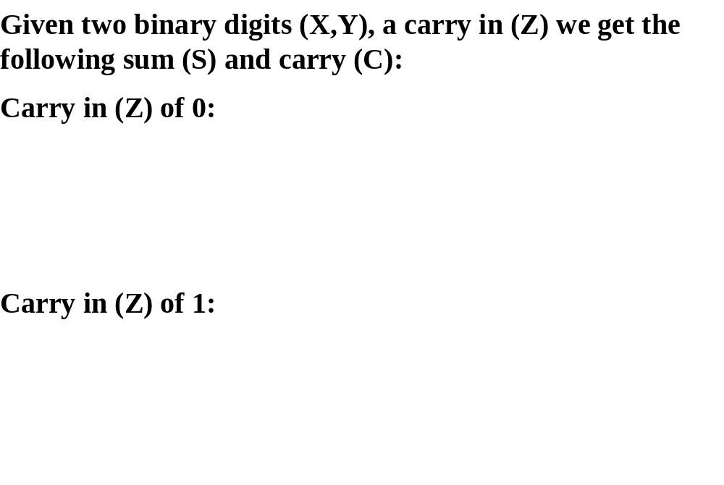
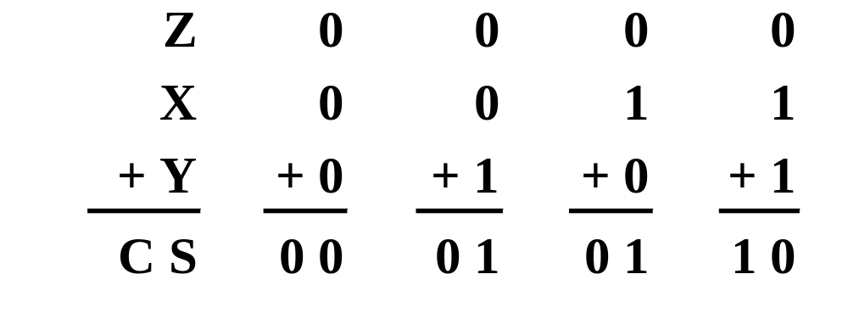
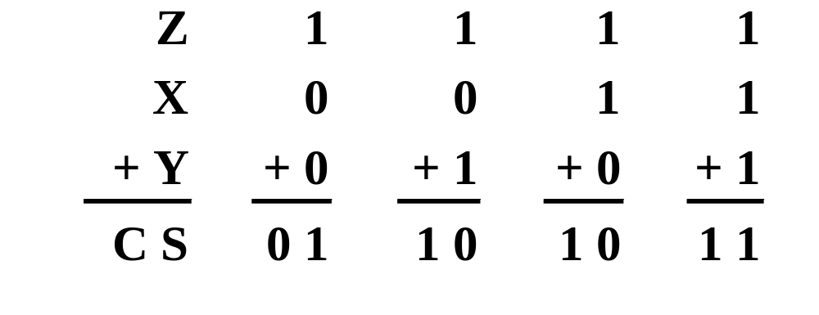
Single Bit Binary Addition with Carry

Slide 39
Multiple Bit Binary Addition
Extending this to two multiple bit examples:
Carries 0 0
Augend 01100 10110
Addend +10001 +10111
Sum
Note: The 0 is the default Carry-In to the least significant bit.
Notes:
Carries 00000 01100
Augend 01100 10110
Addend +10001 +10111
Sum 11101 101101

Slide 40
Single Bit Binary Subtraction with Borrow
Given two binary digits (X,Y), a borrow in (Z) we get the following difference (S) and borrow (B):
Borrow in (Z) of 0:
Borrow in (Z) of 1:
Z
0
0
0
0
X
0
0
1
1
- Y
-0
-1
-0
-1
BS
0 0
1 1
0 1
0 0
Z
1
1
1
1
X
0
0
1
1
- Y
-0
-1
-0
-1
BS
1 1
1 0
0 0
1 1
0 0
0 1
0 1
0 0

Slide 41
Single Bit Binary Subtraction with Borrow
Given two binary digits (X,Y), a borrow in (Z) we get the following difference (S) and borrow (B):
Borrow in (Z) of 0:
Borrow in (Z) of 1:
Z
0
0
0
0
X
0
0
1
1
- Y
-0
-1
-0
-1
BS
0 0
1 1
0 1
0 0
Z
1
1
1
1
X
0
0
1
1
- Y
-0
-1
-0
-1
BS
0
1
1
0
Where, 1 = No need to take borrow
40

Slide 42
Multiple Bit Binary Subtraction
Extending this to two multiple bit examples:
Borrows 0 0
Minuend 10110 10110
Subtrahend - 10010 - 10011
Difference
Notes: The 0 is a Borrow-In to the least significant bit. If the Subtrahend > the Minuend, interchange and append a – to the result.
Notes:
Borrows 00000 00110
Minuend 10110 10110
Subtrahend –10010 –10011
Difference 00100 00011

Slide 43
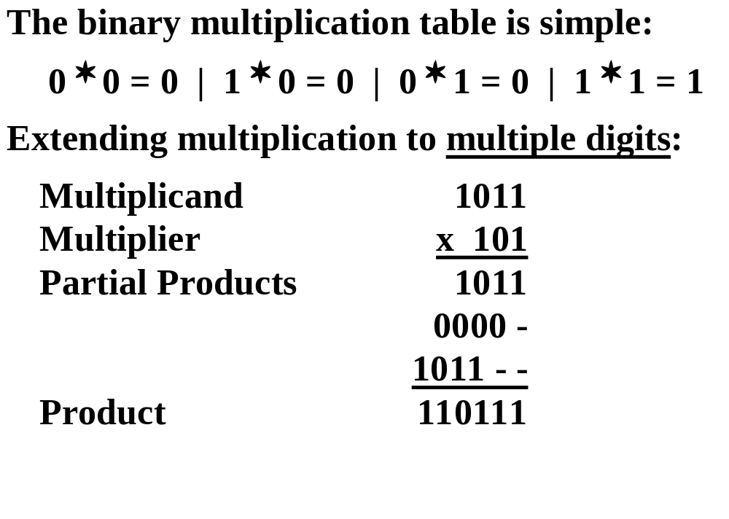
Binary Multiplication
Chapter 1 <number>

Slide 44
BCD Arithmetic
Given a BCD code, we use binary arithmetic to add the digits:
8
1000
Eight
+5
+0101
Plus 5
13
1101
is 13 (> 9)
Note that the result is MORE THAN 9, so must be
represented by two digits!
To correct the digit, subtract 10 by adding 6 modulo 16.
8
1000
Eight
+5
+0101
Plus 5
13
1101
is 13 (> 9)
+0110
so add 6
carry = 1
0011
leaving 3 + cy
0001 | 0011
Final answer (two digits)
If the digit sum is > 9, add one to the next significant digit
Chapter 1 <number>

Slide 45
BCD Addition Example
Add 2905_{BCD} to 1897_{BCD} showing carries and digit corrections.
0
0001 1000 1001 0111
+ 0010 1001 0000 0101
Notes:
1 1 1 0
0001 1000 1001 0111
+ 0010 1001 0000 0101
0100 10010 1010 1100
+ 0000+ 0110+ 0110+ 0110
0100 1000 0000 0010

Slide 46
Error-Detection Codes
Redundancy (e.g. extra information), in the form of extra bits, can be incorporated into binary code words to detect and correct errors.
A simple form of redundancy is parity, an extra bit appended onto the code word to make the number of 1’s odd or even. Parity can detect all single-bit errors and some multiple-bit errors.
A code word has even parity if the number of 1’s in the code word is even.
A code word has odd parity if the number of 1’s in the code word is odd.

Slide 47
4-Bit Parity Code Example
Fill in the even and odd parity bits:
The codeword "1111" has even parity and the codeword "1110" has odd parity. Both can be used to represent 3-bit data.
Even Parity
Odd Parity
Message
-
Parity
Message
-
Parity
000
-
000
-
001
-
001
-
010
-
010
-
011
-
011
-
100
-
100
-
101
-
101
-
110
-
110
-
111
-
111
-
Notes:
Even Parity Bits: 0, 1, 1, 0, 1, 0, 0, 1
Odd Parity Bits: 1, 0, 0, 1, 0, 1, 1, 0

Slide 48
ASCII Character Codes
American Standard Code for Information Interchange
This code is a popular code used to represent information sent as character-based data. It uses 7-bits to represent:
  94 Graphic printing characters.
  34 Non-printing characters
Some non-printing characters are used for text format (e.g. BS = Backspace, CR = carriage return)
Other non-printing characters are used for record marking and flow control (e.g. STX and ETX start and end text areas).
(Refer to Table 1
-4 in the text)

Slide 49
ASCII Properties
ASCII has some interesting properties:
Digits 0 to 9 span Hexadecimal values 30₁₆
to 39₁₆
.
Upper case A
-
Z span 41₁₆
to 5A₁₆
.
Lower case a
-
z span 61₁₆
to 7A₁₆
.
Lower to upper case translation (and vice versa)
occurs by
flipping bit 6.
Delete (DEL) is all bits set,
a carryover from when
punched paper tape was used to store messages.
Punching all holes in a row erased a mistake!

Slide 50
UNICODE
UNICODE extends ASCII to 65,536 universal characters codes
  For encoding characters in world languages
  Available in many modern applications
  2 byte (16-bit) code words

Slide 51
Number representation
Representing whole numbers
Representing fractional numbers

Slide 52
Integer Representations
  Unsigned notation
  Signed magnitude notion
  Excess notation
  Two’s complement notation.

Slide 53
Unsigned Representation
Represents positive integers.
Unsigned representation of 157:
Addition is simple:
1 0 0 1 + 0 1 0 1 = 1 1 1 0.
position | 7 | 6 | 5 | 4 | 3 | 2 | 1 | 0
Bit pattern | 1 | 0 | 0 | 1 | 1 | 1 | 0 | 1
contribution | 2⁷ |  |  | 2⁴ | 2³ | 2² |  | 2⁰

Slide 54
Advantages and disadvantages of unsigned notation
Advantages:
  One representation of zero
  Simple addition
Disadvantages
  Negative numbers can not be represented.
  The need of different notation to represent negative numbers.

Slide 55
Representation of negative numbers
Is a representation of negative numbers possible?
Unfortunately:
  you can not just stick a negative sign in front of a binary number. (it does not work like that)
There are three methods used to represent negative numbers.
  Signed magnitude notation
  Excess notation notation
  Two’s complement notation

Slide 56
Signed Magnitude Representation
Unsigned: - and + are the same.
In signed magnitude
    the left-most bit represents the sign of the integer.
      0 for positive numbers.
      1 for negative numbers.
The remaining bits represent to magnitude of the numbers.

Slide 57
Example
Suppose 10011101 is a signed magnitude representation.
The sign bit is 1, then the number represented is negative
The magnitude is 0011101 with a value 2⁴+2³+2²+2⁰= 29
Then the number represented by 10011101 is –29.
position | 7 | 6 | 5 | 4 | 3 | 2 | 1 | 0
Bit pattern | 1 | 0 | 0 | 1 | 1 | 1 | 0 | 1
contribution | - |  |  | 2⁴ | 2³ | 2² |  | 2⁰

Slide 58
Exercise 1
37₁₀ has 0010 0101 in signed magnitude notation. Find the signed magnitude of –37₁₀ ?
Using the signed magnitude notation find the 8-bit binary representation of the decimal value 24₁₀ and -24₁₀.
Find the signed magnitude of –63 using 8-bit binary sequence?

Slide 59
Disadvantage of Signed Magnitude
Addition and subtractions are difficult.
Signs and magnitude, both have to carry out the required operation.
They are two representations of 0
    00000000 = + 0₁₀
    10000000 = - 0₁₀
    To test if a number is 0 or not, the CPU will need to see whether it is 00000000 or 10000000.
    0 is always performed in programs.
      Therefore, having two representations of 0 is inconvenient.

Slide 60
Signed-Summary
In signed magnitude notation,
    The most significant bit is used to represent the sign.
    1 represents negative numbers
    0 represents positive numbers.
    The unsigned value of the remaining bits represent The magnitude.
Advantages:
    Represents positive and negative numbers
Disadvantages:
    two representations of zero,
    Arithmetic operations are difficult.

Slide 61
Excess Notation
In excess notation:
  The value represented is the unsigned value with a fixed value subtracted from it.
    For n-bit binary sequences the value subtracted fixed value is 2^{(n-1)}.
  Most significant bit:
    0 for negative numbers
    1 for positive numbers

Slide 62
Excess Notation with n bits
1000…0 represent 2^{n-1} is the decimal value in unsigned notation.
Therefore, in excess notation:
  1000…0 will represent 0 .
Decimal value
In unsigned
notation
Decimal value
In excess
notation
- 2^{n-1} =

Slide 63
Example (1) - excess to decimal
Find the decimal number represented by 10011001 in excess notation.
  Unsigned value
    10011000₂ = 2⁷ + 2⁴ + 2³ + 2⁰ = 128 + 16 +8 +1 = 153₁₀
  Excess value:
    excess value = 153 – 2⁷ = 152 – 128 = 25.

Slide 64
Example (2) - decimal to excess
Represent the decimal value 24 in 8-bit excess notation.
We first add, 2⁸⁻¹, the fixed value
  24 + 2⁸⁻¹ = 24 + 128= 152
then, find the unsigned value of 152
  152₁₀ = 10011000 (unsigned notation).
  24₁₀ = 10011000 (excess notation)

Slide 65
example (3)
Represent the decimal value -24 in 8-bit excess notation.
We first add, 2⁸⁻¹, the fixed value
  -24 + 2⁸⁻¹ = -24 + 128= 104
then, find the unsigned value of 104
  104₁₀ = 01101000 (unsigned notation).
  -24₁₀ = 01101000 (excess notation)

Slide 66
Example (4) (10101)
Unsigned
  10101₂ = 16+4+1 = 21₁₀
  The value represented in unsigned notation is 21
Sign Magnitude
  The sign bit is 1, so the sign is negative
  The magnitude is the unsigned value 0101₂ = 5₁₀
  So the value represented in signed magnitude is -5₁₀
Excess notation
  As an unsigned binary integer 10101₂ = 21₁₀
  subtracting 2⁵⁻¹ = 2⁴ = 16, we get 21-16 = 5₁₀.
  So the value represented in excess notation is 5₁₀.

Slide 67
Advantages of Excess Notation
It can represent positive and negative integers.
There is only one representation for 0.
It is easy to compare two numbers.
When comparing the bits can be treated as unsigned integers.
Excess notation is not normally used to represent integers.
It is mainly used in floating point representation for representing fractions (later floating point rep.).

Slide 68
Exercise 2
Find 10011001 is an 8-bit binary sequence.
  Find the decimal value it represents if it was in unsigned and signed magnitude.
  Suppose this representation is excess notation, find the decimal value it represents?
Using 8-bit binary sequence notation, find the unsigned, signed magnitude and excess notation of the decimal value 11₁₀ ?

Slide 69
Excess notation - Summary
In excess notation, the value represented is the unsigned value with a fixed value subtracted from it.
  i.e. for n-bit binary sequences the value subtracted is 2^{(n-1)}.
Most significant bit:
  0 for negative numbers .
  1 positive numbers.
Advantages:
  Only one representation of zero.
  Easy for comparison.

Slide 70
Two’s Complement Notation
The most used representation for integers.
  All positive numbers begin with 0.
  All negative numbers begin with 1.
  One representation of zero
    i.e. 0 is represented as 0000 using 4-bit binary sequence.

Slide 71
Two’s Complement Notation with 4-bits
Binary pattern for 2’s complement Value.
0 1 1 1 7
0 1 1 0 6
0 1 0 1 5
0 1 0 0 4
0 0 1 1 3
0 0 1 0 2
0 0 0 1 1
0 0 0 0 0
1 1 1 1 -1
1 1 1 0 -2
1 1 0 1 -3
1 1 0 0 -4
1 0 1 1 -5
1 0 1 0 -6
1 0 0 1 -7
1 0 0 0 -8

Slide 72
Properties of Two’s Complement Notation
Positive numbers begin with 0
Negative numbers begin with 1
Only one representation of 0, i.e. 0000
Relationship between +n and –n.
  0 1 0 0 +4 0 0 0 1 0 0 1 0 +18
  1 1 0 0 -4 1 1 1 0 1 1 1 0 -18

Slide 73
Advantages of Two’s Complement Notation
It is easy to add two numbers.
    0 0 0 1 +1 1 0 0 0 -8
    0 1 0 1 +5 0 1 0 1 +5
+
+
0 1 1 0 +6 1 1 0 1 -3
Subtraction can be easily performed.
Multiplication is just a repeated addition.
Division is just a repeated subtraction
Two’s complement is widely used in ALU

Slide 74
Evaluating numbers in two’s complement notation
Sign bit = 0, the number is positive. The value is determined in the usual way.
Sign bit = 1, the number is negative. three methods can be used:
Method 1 | decimal value of (n-1) bits, then subtract 2^{n-1}
Method 2 | - 2^{n-1} is the contribution of the sign bit.
Method 3 | Binary rep. of the corresponding positive number. Let V be its decimal value. - V is the required value.

Slide 75
Example- 10101 in Two’s Complement
The most significant bit is 1, hence it is a negative number.
Method 1
    0101 = +5 (+5 – 2⁵⁻¹ = 5 – 2⁴ = 5-16 = -11)
Method 2
    4 3 2 1 0
    1 0 1 0 1
    -2⁴ 2² 2⁰ ⁼ -11
Method 3
    Corresponding + number is 01011 = 8 + 2+1 = 11
    the result is then –11.

Slide 76
Two’s complement-summary
In two’s complement the most significant for an n-bit number has a contribution of –2^{(n-1)}.
One representation of zero
All arithmetic operations can be performed by using addition and inversion.
The most significant bit: 0 for positive and 1 for negative.
Three methods can the decimal value of a negative number:
Method 1 | decimal value of (n-1) bits, then subtract 2^{n-1}
Method 2 | - 2^{n-1} is the contribution of the sign bit.
Method 3 | Binary rep. of the corresponding positive number. Let V be its decimal value. - V is the required value.

Slide 77
Exercise - 10001011
Determine the decimal value represented by 10001011 in each of the following four systems.
    Unsigned notation?
    Signed magnitude notation?
    Excess notation?
    Tow’s complements?

Slide 78
Fraction Representation
To represent fraction we need other representations:
  Fixed point representation
  Floating point representation.

Slide 79
Fixed-Point Representation
old position 7 6 5 4 3 2 1 0
New position 4 3 2 1 0 -1 -2 -3
Bit pattern 1 0 0 1 1 . 1 0 1
Contribution 2⁴ 2¹ 2⁰ 2⁻¹ 2⁻³ =19.625
Radix-point

Slide 80
Limitation of Fixed-Point Representation
To represent large numbers or very small numbers we need a very long sequences of bits.
This is because we have to give bits to both the integer part and the fraction part.

Slide 81
Floating Point Representation
In decimal notation we can get around this
problem using scientific notation or floating
point notation.
Number | Scientific notation | Floating-point notation
1,245,000,000,000 | 1.245 10¹² | 0.1245 10¹³
0.0000001245 | 1.245 10⁻⁷ | 0.1245 10⁻⁶
-0.0000001245 | -1.245 10⁻⁷ | -0.1245 10⁻⁶

Slide 82
Floating Point
-15900000000000000
could be represented as
Base
Mantissa
Exponent
Sign
- 159 * 10¹⁴
- 15.9 * 10¹⁵
- 1.59 * 10¹⁶
A calculator might display 159 E14
Notes:
When we deal with very large and very small numbers we often resort to using scientific notation.
Calculators, for example, often represent the results of large calculations this way because there is an insufficient number of digits to show the result normally
159 is called the mantissa 14 the exponent which is the number of places to move the decimal point.

Slide 83
Floating point format
± M × B ^{±E}
Sign mantissa or base exponent
significand
Sign
Exponent
Mantissa

Slide 84
Floating Point Representation format
The exponent is biased by a fixed value b, called the bias.
The mantissa should be normalised, e.g. if the real mantissa if of the form 1.f then the normalised mantissa should be f, where f is a binary sequence.
Sign
Exponent
Mantissa

Slide 85
IEEE 745 Single Precision
The number will occupy 32 bits
  The first bit represents the sign of the number;
  1= negative 0= positive.
  The next 8 bits will specify the exponent stored in biased 127 form.
  The remaining 23 bits will carry the mantissa normalised to be between 1 and 2.
  i.e. 1<= mantissa < 2

Slide 86
Representation in IEEE 754 single precision
sign bit:
  0 for positive and,
  1 for negative numbers
8 biased exponent by 127
23 bit normalised mantissa
Sign
Exponent
Mantissa

Slide 87
Basic Conversion
Converting a decimal number to a floating point number.
  1.Take the integer part of the number and generate the binary equivalent.
  2.Take the fractional part and generate a binary fraction
  3.Then place the two parts together and normalise.

Slide 88
IEEE – Example 1
Convert 6.75 to 32 bit IEEE format.
1. The Mantissa. The Integer first.
6 / 2 = 3 r 0
3 / 2 = 1 r 1
1 / 2 = 0 r 1
2. Fraction next.
.75 * 2 = 1.5
.5 * 2 = 1.0
3. put the two parts together… 110.11
Now normalise 1.1011 * 2²
= 110₂
= 0.11₂

Slide 89
IEEE – Example 1
Convert 6.75 to 32 bit IEEE format.
1. The Mantissa. The Integer first.
6 / 2 = 3 r 0
3 / 2 = 1 r 1
1 / 2 = 0 r 1
2. Fraction next.
.75 * 2 = 1.5
.5 * 2 = 1.0
3. put the two parts together… 110.11
Now normalise 1.1011 * 2²
= 110₂
= 0.11₂

Slide 90
IEEE – Example 1
Convert 6.75 to 32 bit IEEE format.
1. The Mantissa. The Integer first.
6 / 2 = 3 r 0
3 / 2 = 1 r 1
1 / 2 = 0 r 1
2. Fraction next.
.75 * 2 = 1.5
.5 * 2 = 1.0
3. put the two parts together… 110.11
Now normalise 1.1011 * 2²
= 110₂
= 0.11₂

Slide 91
IEEE Biased 127 Exponent
To generate a biased 127 exponent
Take the value of the signed exponent and add 127.
Example.
2¹⁶ then 2¹²⁷⁺¹⁶ = 2¹⁴³ and my value for the exponent would be 143 = 10001111₂
So it is simply now an unsigned value ....

Slide 92
Possible Representations of an Exponent
Binary | Sign Magnitude | 2's Complement | Biased 127 Exponent XXX |  |  | Biased 127 Exponent IEEE 754
00000000 | 0 | 0 | 0+127 | 127 |  | 0-127 | -127
00000001 | 1 | 1 | 1+127 | 128 |  | 1-127 | -126
00000010 | 2 | 2 | 2+127 | 129 |  | 2-127 | -125
01111110 | 126 | 126 | 126+127 | 253 |  | 126-127 | -1
01111111 | 127 | 127 | 127+127 | 254 |  | 127-127 | 0
10000000 | -0 | -128 | 0+127 | 127 |  | 128-127 | 1
10000001 | -1 | -127 | -1+127 | 126 |  | 129-127 | 2
11111110 | -126 | -2 | -126+127 | 1 |  | 254-127 | 127
11111111 | -127 | -1 | -127+127 | 0 |  | 255-127 | 128

Slide 93
Why Biased ?
The smallest exponent 00000000
Only one exponent zero 01111111
The highest exponent is 11111111
To increase the exponent by one simply add 1 to the present pattern.

Slide 94
Back to the example
Our original example revisited…. 1.1011 * 2²
Exponent is 2+127 =129 or 10000001 in binary.
NOTE: Mantissa always ends up with a value of ‘1’ before the Dot. This is a waste of storage therefore it is implied but not actually stored. 1.1000 is stored .1000
6.75 in 32 bit floating point IEEE representation:-
0 10000001 10110000000000000000000
sign(1) exponent(8) mantissa(23)

Slide 95
Representation in IEEE 754 single precision
sign bit:
  0 for positive and,
  1 for negative numbers
8 biased exponent by 127
23 bit normalised mantissa
Sign
Exponent
Mantissa

Slide 96
Example (2)
which number does the following IEEE single precision notation represent?
The sign bit is 1, hence it is a negative number.
The exponent is 1000 0000 = 128₁₀
It is biased by 127, hence the real exponent is
128 –127 = 1.
The mantissa: 0100 0000 0000 0000 0000 000.
It is normalised, hence the true mantissa is
1.01 = 1.25₁₀
Finally, the number represented is: -1.25 x 2¹ = -2.50
1
1000 0000
0100 0000 0000 0000 0000 000

Slide 97
Single Precision Format
The exponent is formatted using excess-127 notation, with an implied base of 2
  Example:
    Exponent: 10000111
    Representation: 135 – 127 = 8
The stored values 0 and 255 of the exponent are used to indicate special values, the exponential range is restricted to
2⁻¹²⁶ to 2¹²⁷
The number 0.0 is defined by a mantissa of 0 together with the special exponential value 0
The standard allows also values +/-∞ (represented as mantissa +/-0 and exponent 255
Allows various other special conditions

Slide 98
In comparison
The smallest and largest possible 32-bit integers in two’s complement are only -2³² and 2³¹ - 1

Slide 99
Range of numbers
Normalized (positive range; negative is symmetric)
smallest
+2⁻¹²⁶× (1+0) = 2⁻¹²⁶
00000000100000000000000000000000
largest
+2¹²⁷× (2-2⁻²³)
01111111011111111111111111111111
2¹²⁷(2-2⁻²³)
0
2⁻¹²⁶
Positive underflow
Positive overflow

Slide 100
Representation in IEEE 754 double precision format
It uses 64 bits
  1 bit sign
  11 bit biased exponent
  52 bit mantissa
Sign
Exponent
Mantissa

Slide 101
IEEE 754 double precision
Biased = 1023
11-bit exponent with an excess of 1023.
For example:
  If the exponent is -1
    we then add 1023 to it. -1+1023 = 1022
    We then find the binary representation of 1022
      Which is 0111 1111 110
    The exponent field will now hold 0111 1111 110
  This means that we just represent -1 with an excess of 1023.

Slide 102
IEEE 754 Encoding
Single Precision |  | Double Precision |  | Represented Object
Exponent | Fraction | Exponent | Fraction
0 | 0 | 0 | 0 | 0
0 | non-zero | 0 | non-zero | +/- denormalized number
1~254 | anything | 1~2046 | anything | +/- floating-point numbers
255 | 0 | 2047 | 0 | +/- infinity
255 | non-zero | 2047 | non-zero | NaN (Not a Number)

Slide 103
Floating Point Representation format (summary)
the sign bit represents the sign
  0 for positive numbers
  1 for negative numbers
The exponent is biased by a fixed value b, called the bias.
The mantissa should be normalised, e.g. if the real mantissa if of the form 1.f then the normalised mantissa should be f, where f is a binary sequence.
Sign
Exponent
Mantissa

Slide 104
Character representation- ASCII
ASCII (American Standard Code for Information Interchange)
It is the scheme used to represent characters.
Each character is represented using 7-bit binary code.
If 8-bits are used, the first bit is always set to 0
See (table 5.1 p56, study guide) for character representation in ASCII.

Slide 105
ASCII – example
Symbol decimal Binary
7 55 00110111
8 56 00111000
9 57 00111001
: 58 00111010
; 59 00111011
< 60 00111100
= 61 00111101
> 62 00111110
? 63 00111111
@ 64 01000000
A 65 01000001
B 66 01000010
C 67 01000011

